Slide 1
BUISNESS PLAN
Getting bored?
KILL BOREDOM !

Slide 2
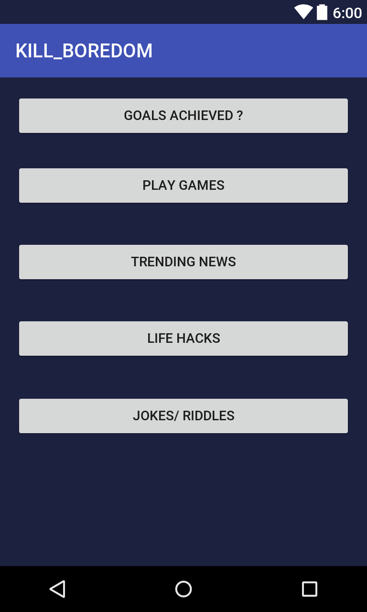
KILL BOREDOM ! (APP DESCRIPTION)
As the name suggests this App is designed to kill your boredom !
Y feel bore or stay idle when we have so much to learn , so much to do and so much to play!
App keeps a track of your goals whether they are completed or not ?
Selected and simplified news for you to be updated with current affairs and trends.
Cool and simple time pass games as well as multiplayer games.
Useful life hacks , awesome jokes and riddles.
It works offline too.
Basically apps either reminds you to do something or turn your boredom into a useful activity.

Slide 3
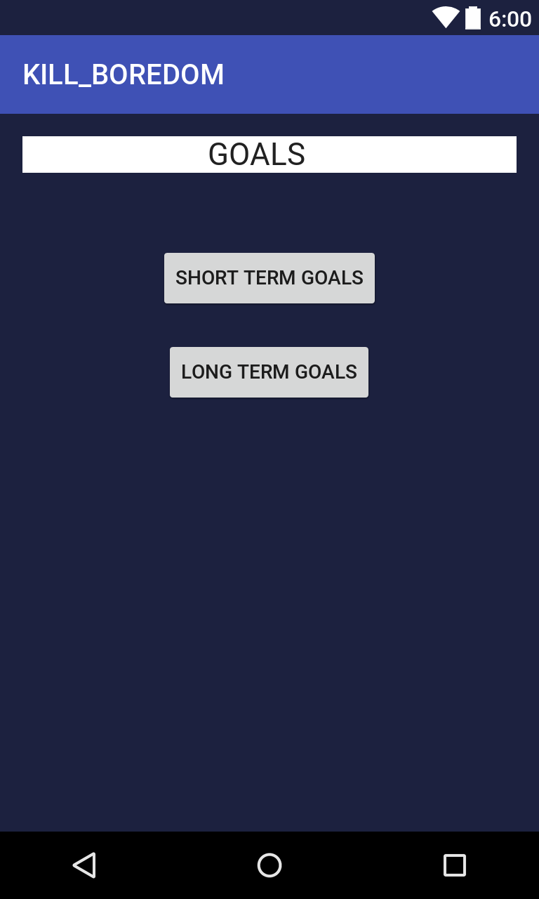
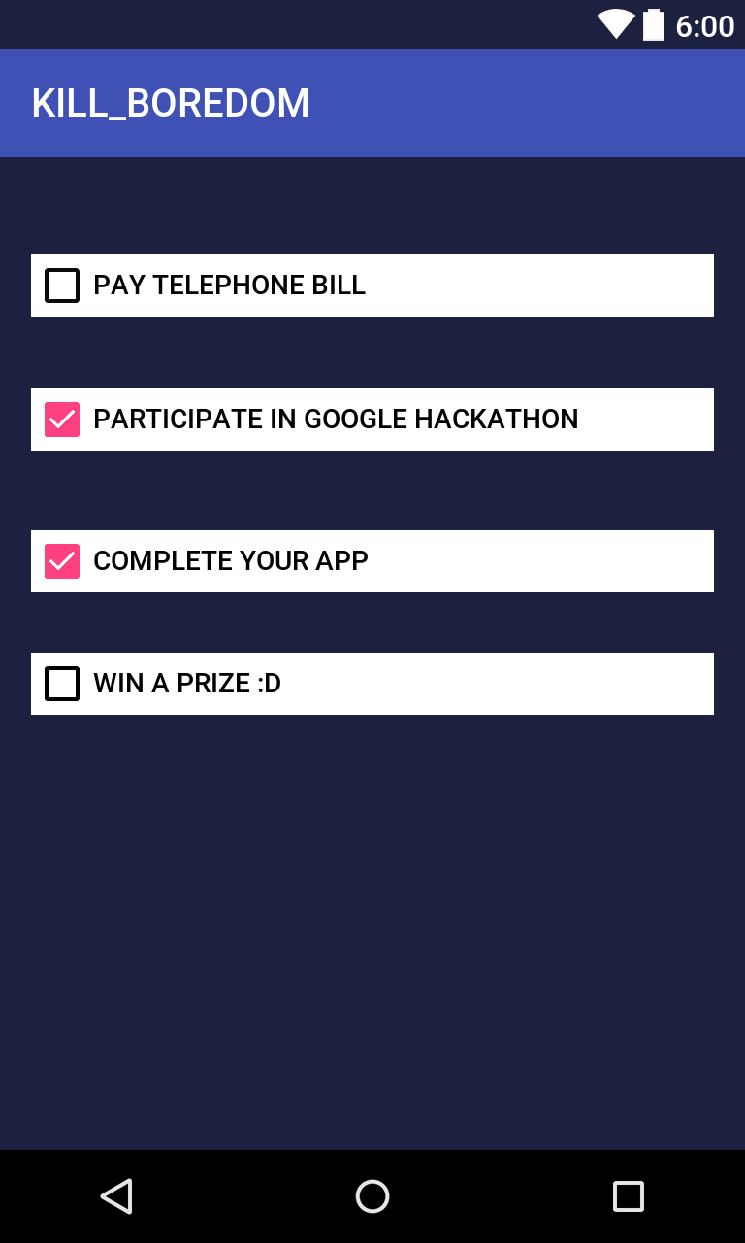
GOALS ACHIEVED ? It may happen that u actually have work to do but you forgot . Kill boredom will remind u if u have any goals left and is yes then you can utilize your time. This feature will surely attract people who forget very easily the things which they have to do. Especially youngsters have lot of work to handle and it may happen that they forget something which is important !

Slide 4
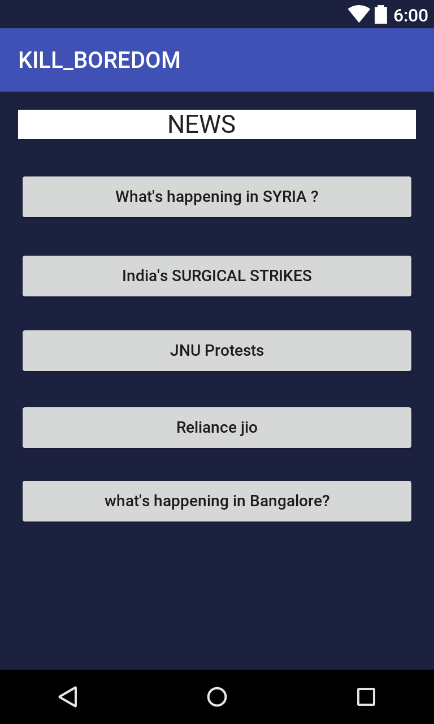
Simplified and important News
Many people especially the youth of this generation will always be eager to know about trends and the important things going around in this world !
Kill boredom will give News but not like any other news channel or App but in a simplified and in a brief way so that is becomes easier to understand and form an opinion rather than listening to an untrusted source.
All the news will not be shown that will make the app boring itself !
Top selected news which will go in trend will be shown and that too on a proper time !

Slide 5
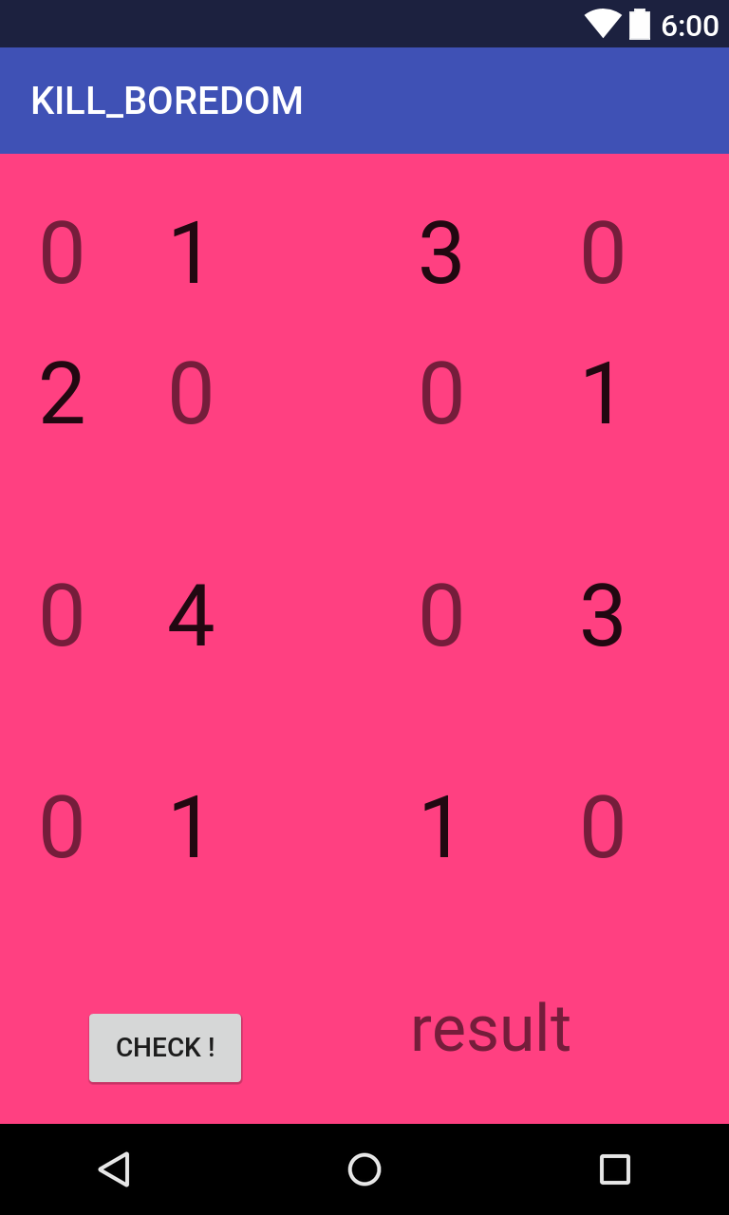
GAMES,RIDDLES,JOKES,LIFEHACKS !
Not just games but MIND GAMES !
Sudoku 4x4, 9x9 and more games like chain reaction , 1028 etc.
Games can be a great time pass !
Riddles will make you think , jokes will increase your sense of humour and life hacks can be useful in many situations.
What we believe is doing anything above is just better than getting bored or sitting idle !

Slide 6
Comparision of what we deliver and what market want !
Market trends
Kill boredom
People need something to constantly remind them to do the left over work.
They are eager know only what’s trending around the world.
They need cool things for timepass social media is too main stream now a days .
Kill Boredom goals section reminds them with primary or secondar goals !
Kill boredom delivers them news in simplified way and is limited to selective points
Awsomelife hacks and riddles will surprise them and make them think !

Slide 7
Target audience :
Most part of this generation which uses mobile apps is the youth.
Kill boredom is made to target youth as its audience as it gives solutions to the problems which youth are facing these days . (they never want to be bored !)
Youth usually are interested in forming a firm opinion about what's going around the world, they share their opinions among their friends and hence it becomes important for them to know the trending news.
Jokes , riddles and life hacks will surprise them !

Slide 8
SWOT ANALYSIS:
STRENGTH:
Sums up may things in a single Aap.
The name ‘Kill Boredom’ itself attracts the users to use it in the idle time
Works even when you are offline !
WEEKNESS:
May not be a useful app for certain types of people.
People with more advanced accessories around like a computer may prefer that for a timepass.

Slide 9
SWOT ANALYSIS:
OPPOTUNITIES:
My develop this application much further so that it becomes addicted to user.
If this apps becomes enough popular we can advertise companies via aap.
Can sum up more things like budget handler, etc. so that people start using it not only when they are getting bored but in their work time also.
THREATS:
People may find a more entertaining source like watching movies.

Slide 10
STILL FEELING BORED ??!?!? JUST KILL_BOREDOM IT !

